Slide 1
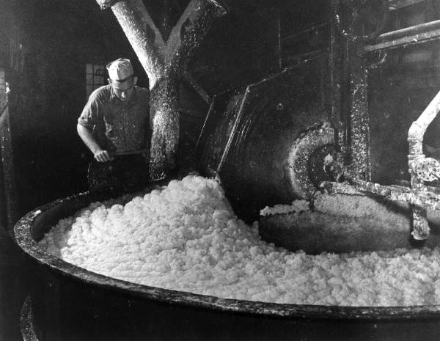
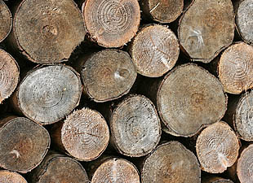
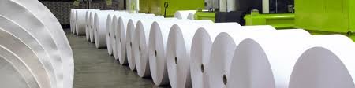


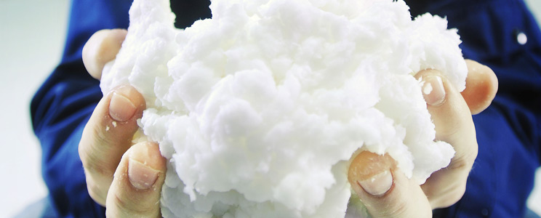
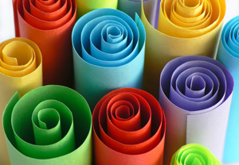
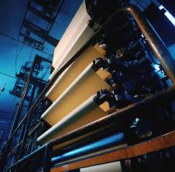
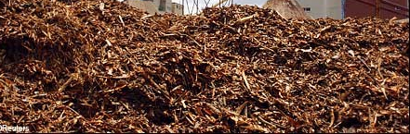
PAPER AND PULP
INDUSTRIES

Slide 2
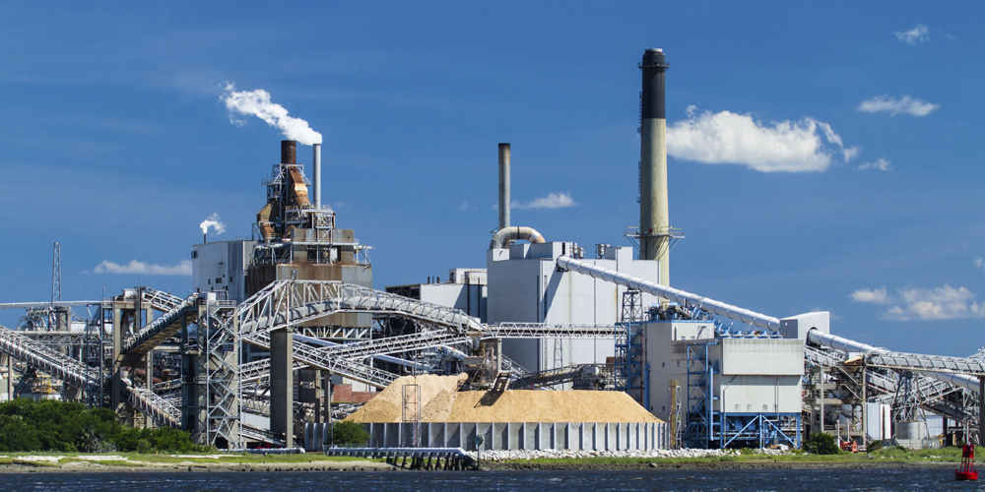

Slide 3
HISTORY
Paper has a rich, colourful history which has spanned the world's geography and its cultures.
Paper as we know it today comes from another source - China.
It wasn't until the 3rd century that the secret art of papermaking began to creep out of China, first to Vietnam and then Tibet. It was introduced in Korea in the 4th century and spread to Japan in 6th.

Slide 4
Papermaking spread slowly throughout Asia to Nepal and later to India. It made its true push westward in 751AD.
The birth of the modern paper and printing industry is accredited to JOHANN GUTENBURG
In Europe and America,in the 18th century the mass-production of paper became a thriving industry supplying huge volumes of paper for the production of newspapers, books, magazines, paper bags, toilet paper, money and a huge variety of other purposes - including clothing, chimney's and even coffins!

Slide 5
Raw materials for the pulping industry

Slide 6
Requisites for Cellulose raw materials
Ample supply
Available to pulp mill throughout the year
Should not deteriorate in storage
High yield of quality fibre
Capable of being collected and stored in a small area and transported, if necessary at low cost
Cost of conversion to paper must be low
Quality of paper made must be competitive
Must not have a higher priority use

Slide 7
Major inputs for pulp production
Fiber Softwood Hardwood Non wood fibres Recovered/recycled fibre
Chemicals
Energy
water

Slide 8
Raw materials for Paper production

Slide 9
Fibrous raw materials
Paper pulp: groundwood, chemical, semi chemical pulps- bleached or unbleached
Reuse pulp: recycled or repulped paper products like newspapers, paperboard etc..mixed with new pulp
Miscellaneous cellulose pulp: straw, linen, cotton, jute, rags
Speciality pulp: inorganic fibres such as asbestos and glass

Slide 10
Non fibrous raw materials
For fillers, sizing and coating, finishing processes
Inorganic:
Clay, talc, titanium dioxide, zinc sulfide, calcium carbonate, calcium sulphate, barium sulphate, alum etc..
Organic:
Rosin, glue, caesin, waxes, glycerol, dyestuffs etc..

Slide 11

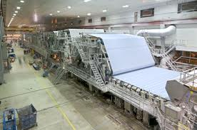
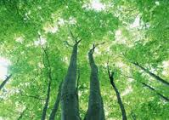
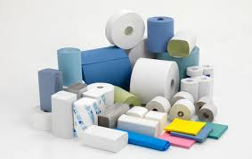
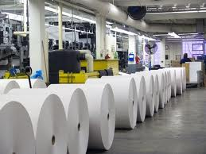

Slide 12
Production of pulp

Slide 13
Digestion of wood-base material
Logs with barks are debarked using tumbling and rubbing actions.
With the bark removed the logs are conveyed to chippers where large rotary disks with many heavy knives reduce the wood to 2-5 cm flat chips.
Chips are sent to deaerator-preheater after which the chips are discharged into the lift line where the recirculating digestion liquor at 12atms transfer the chips to the upper soaking zone of the digestor tower
The length of a digestor tower is 25-30 m.

Slide 14
The chips flow down a series of circumferential screen plates.
The cooking liquor is used as a side streams and is used to normalize the temperature through external heat exchangers
The digestion time and temperature is adjusted so that maximum lignin could be removed. Apart from that cellulose hydrolysis is also minimized.
The digested chips are cooled at the bottom of the digestor by injection of cold black liquor.
Pulp liquor slurry is passed to the blow tank where residual heat is recovered and sent in the form of steam to the pre-heater.

Slide 15
turpentine recovery
knots &
undigested
residue
Digestor
chips
140-
150
deg
C
chip bin
blow
tank
steam
screen
170-180 degC
steam
recirculating
liquor
65 degC
strainer
12-14 atms
black liquor purge
blow down
valve
mix
tank
4-stage
centrifugal
pump
To chemical recovery
Black liquor
modifying
streams
white
liquor
Paper mill
Pulp to bleaching plant ( 30%)

Slide 16
Bleaching of pulp
A cheap oxidizing agent could be used for the removal of color residue.
Traditionally, chlorine-type oxidizing agent were used but this has been changing in recent times because the action of chlorine produces dioxins and other undesirable components.
The new trend has deviated towards the use of hydrogen peroxide as the oxidizing agent for bleaching.

Slide 17
Finishing operation
Pulp is used in the production of paper so if a plant has both the pulp and paper producing units in it then the wet pulp can directly be sent to beater operations.
Otherwise, dewatered pulp can be shipped to any distances in several ways
- wet lap sheets by hydraulic pressing; dried later
- Dry fluffy material by vacuum flash drying
- in the form of noodles or pellets

Slide 18
Recovery of chemicals
Black liquor used in the digestion process contains 98-99% of digestion chemicals.
So, to avoid air and water pollution the chemicals need to be recovered.
A multiple effect evaporation unit with 5-6 stages is used to convert the concentration of the liquor from 15-16% solids to 60% solids.
In the smelting furnace the organic carbon burns supplying heat and carbon dioxide.
The carbon dioxide is used to make molten slag.
Sodium sulphate is added as make-up.

Slide 19
The slag mixes with water in the dissolver to yield green liquor.
Insoluble impurities are settled and removed
The residing liquor is then causticized using lime.
Filtration is done to remove calcium carbonate while the filtrate that is the white liquor is returned to the digestor.
Calcium carbonate is converted back to lime and recycled

Slide 20
Lime Kiln:
Lime mud is introduced at the uphill, feed end and it slowly makes its way to the discharge end due to inclination.
Fuel is burnt at the discharge end.
The causticizing reaction precipitates CaCO3 which is separated from liquor. The calcium carbonate is dewatered on a pre-coat filter to a solids of content 65% or higher. The resulting lime mud is fed into a rotary kiln where it is dried and heated counter currently.
As the mud temperature reaches about 800 deg.C in the calcination zone of the kiln, CaCO3 decomposes into CaO and CO2.

Slide 21


The rotary kilns in the pulp and paper industry range in size from 7-13.5 ft. diameter and 175-400ft in length.
Production capacity ranges from 50tons/day to 45 tons/day of CaO.

Slide 22
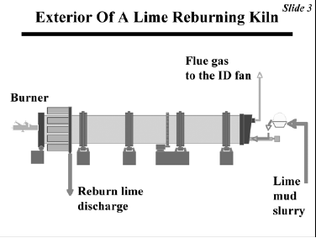

Slide 23
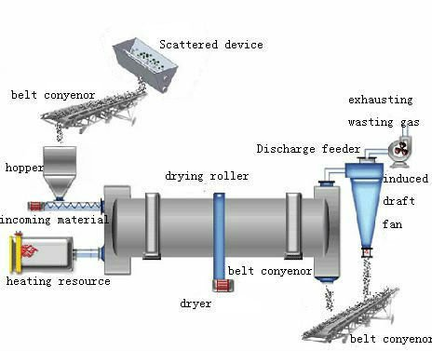

Slide 24
Stack
Clarifier
Make-up Lime
Six-Effect Evaporator system:
Counter-current feed
48-54% solids
28-30 atms
steam
Hot flue gas
Cottrell precipitator
Air
Mix tank
Green liquor
Boiler section
Make-up chemicals
Na2SO4
waste
sludge
Lime slaker
Washing tanks
Black liquor(15-18% solids)
smelt
dissolve tank
Causticizing tank
To digestors
White
liquor
storage
Steam
Fuel
Stack
Clarifier
Sludge
Carbonate mud
Lime
kiln
Reburned lime

Slide 25
Distinguishing liquors
Black liquor:
In the Kraft process wood chips and pulping chemicals are dissolved to form black liquor.
Globally 1.3 billion tons of black liquor per year is processed of which 200 million are burnt in the boilers to recover cooking chemicals like Na2O.
This makes black liquor fifth most important fuel in the world.
Green liquor:
Black liquor is sprayed into the lower part of the recovery boiler where Na2S is formed
The inorganic sodium and sulpher are recovered as Na2S and Na2CO3.
The molten smelt mixes with water to form green liquor.

Slide 26
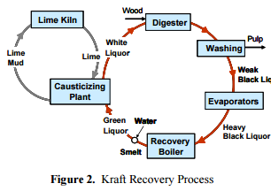
White liquor:
Green liquor is cauticized using lime to convert Na2CO3 to NaOH.
Na2S passes unchanged.

Slide 27
For baggase
Bagasse usually contains fibres which are much more difficult to break.
Besides, bagasse also contains other substances like pith and dirt.
So for pulp production using bagasse, depithing method is used.
Depithing exposes baggage to strong shredding and grinding actions to reduce pith to finer powder and size of the fibres reduced.
Apart from the above methods we can also use chemical and alkaline pulping which allows rapid penetration of bagasse.

Slide 28
Paper production
Types of paper products:
- wrapping paper
- Tissue paper
- Book paper
- Writing paper
- Ground wood printing paper
- Paperboard

Slide 29
Raw materials used:
- Paper pulp
- Re-use pulp
- Miscellaneous pulp
- Speciality pulp
- Inorganic/Organic raw materials

Slide 30
Paper production methods
Pre-formation:
Pulps are water slurried (0.5-0.75% fibre content) by mechanical disintegrators
Fillers are added to give properties like brightness, flexibility, opacity and softness
Sizing done to modify liquid penetration
Synthetic organic dyestuffs added as colouring agents

Slide 31
Preparation:
Forming a wet web
Removal of free water from wet water from wet web by wet pressing and compaction
Removal of water by heating rolls
As the sheet leaves with 5-6% water it is passed through a series of calendering
Rolls to produce a smooth, well-finished paper.

Slide 32
Make up water
Pulp stock
Pulp with 99.5% H20
Beater
Drying blanket
Calendering
roll
Pressure roll
Water mark roll
Winding roll
Suction roll
White water
Finished paper
Bleed Stream

Slide 33
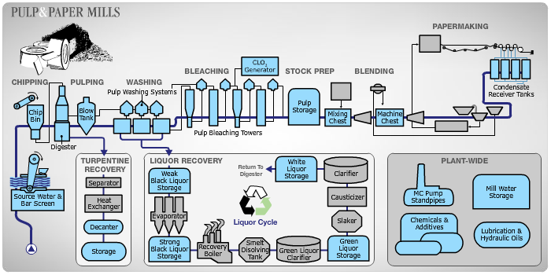

Slide 34
Major Process problems

Slide 35
Choice of Process
The 2 main processes are the sulfate and the sulfite process.
The sulfate process is preferred as :-
Sulfate fibers are stronger.
Raw material quality has less significance in sulfate process.

Slide 36
Pollution & waste disposal
Paper mills require quantities of water as high as 150m³/t. As per CREP requirements, the level of water consumption has to be reduced to 100-125 m³/t.
The paper industry releases dioxins, furans and wastewater are known to carry high levels of BOD, COD and suspended solids.

Slide 37
Use of soda process
Small plants (20-25 tons/day) initially set up in India use a process which involves hydrolysis with NaOH and Na2CO3 in 4:1 ratio.
The advantage is lower cost as chemicals are not recovered in this process and no sulfur required as in sulfate process.

Slide 38
The soda process produces inferior grade pulp at high cost in batch operations and is not used for large tonnage plants where recovery of chemicals is an economic necessity.

Slide 39
By-product utilization
The gum, resin and oil fraction from softwood is a source of naval store products of rosin and turpentine. These are obtained from the gum flowing from coniferous trees and from their stumps by steam distillation or from chemical pulp processes.

Slide 40
Up to 10 million tons/year of lignin is produced which can have the following potential uses :-
1. Dispersants for concrete, dyes, agro-chemicals, etc.
2. Millions of tons of lignin will be potentially available once
lignocellulosic biomass becomes a widely used industrial source
of alcohol.
Major producers of lignin in India are :-
1. A B C Paper Limited – Chandigarh
2. Orkla India Pvt. Ltd. – Mumbai
3. Expanded Polymers System Pvt. Ltd. - Gujarat

Slide 41
Future trends

Slide 42
Borate autocausticizing
The process involves adding sodium borate into the liquor system so that it forms Na3BO3 in the recovery boiler smelt.
Na3BO3 dissociates into NaOH and NaBO2 in the dissolving tank. Thus, it is possible to causticize a portion of Na2CO3 in a recovery boiler with a small amount of borate, and complete the causticizing of the remaining Na2CO3 in the causticizing plant with a reduced amount of lime.

Slide 43
Since no capital investment is required, partial autocausticizing is an attractive alternative for kraft mills where incremental causticizing and lime kiln capacity are needed

Slide 44
Alternative fuels for lime kilns
The lime kiln is the biggest user of fossil fuels in the kraft process.
With escalation in costs of oil and natural gas, there has been a considerable effort in finding alternative fuels. Some of them are petroleum coke and gas from wood waste and bark gassifiers.

Slide 45
Economics of Paper and Pulp industry

Slide 46
World paper production (2011)
According to statistical data by RISI , main paper producing countries in the world are :
China - 99.3 million tons
USA - 75 million tons
Japan - 26.6 million tons
Germany - 22.7 million tons
Canada - 12.1 million tons
India - 6 million tons

Slide 47
Economic challenges faced by Indian paper and pulp industries
Lack of forest resources
Shortage of Chemicals
Lack of good quality equipment
Global Competition

Slide 48
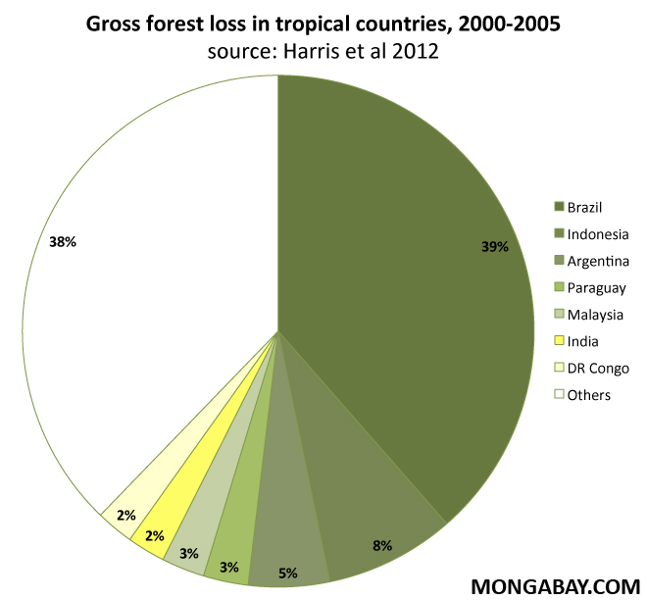
Lack of forest resources
India lost 2 % of its forest reserves in just 5 years.
With increasing restrictions on deforestation, raw material cost increasing.
Only 36% raw material comes from good quality forest resources.

Slide 49
Shortage of Chemicals
Shortages of sulphur, salt cake and chlorine in India has placed the industry at great disadvantage hence affecting its export.
Focusing on chemical recovery methods is a must for indian industries.

Slide 50
Procurement of Equipments
Pulping equipments are simple enough and are being built in India.
However due to their complexity , paper making machinery are not manufactured indigenously and are hence imported.
This increases capital cost and places the country at disadvantage on international market.
Most of the mills operating in India operate on technologies which are on average 30 years older than the ones in Europe.

Slide 51
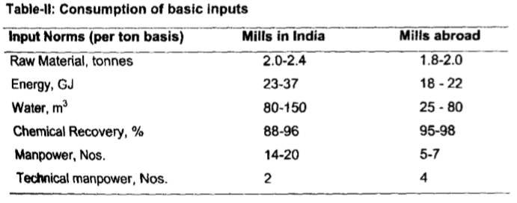
*Mathur R.M., Thapliyal B.P., Singh K., IPPTA J. Vol. No.21, 2009.

Slide 52
Global Competition
Paper produced by Indian mills have higher production costs because of the lack of raw material, chemicals and inefficient machinery.
Resorting to low quality raw materials (agro residues and recycled fiber) instead of good quality cellulosic material (forest resource) also affects the quality of paper produced thus reducing its price in global market.

Slide 53
Overcoming Challenges
Raw material issues :
Since to improve quality forest resources are most important, degraded forest lands should be offered to industries by government to ensure reforestation.
Agro residues should be replaced with good quality recycled paper.
Recycling 1 tonne of paper saves (Data by ITC ltd.)–
Approximately 17 trees
4000 KW power
26500 l water

Slide 54
Technological issues
Proven foreign technologies must be acquired by the government for industries.
Since the current industries are extremely technologically backward, modernization is a capital intensive project and hence financial support to the industries through long term loans is a must.
(100% FDI for the paper industries has been approved by government).

